Slide 1
Provisioning Portfolio
Agenda
    Provisioning Functionality
    Provisioning Architecture
    Platform, TIBCO Products used, Main Skills
    Applications
    Team’s Responsibilities
    Migratable FTEs

Slide 2
Provisioning Functionality
What is Provisioning?
  Providing telecommunications service to a user
    Everything necessary to set up the service, such as equipment, wiring, and transmission
  Providing customer services, logging transactions, carrying out requests, and updating files
  Automation of all the steps required to manage (setup, amend, and revoke) user or system access entitlements or data relative to electronically published services
  Configuration of both hardware and software to activate service
  Consists of commands and controls for specific telecommunication devices
  Assists in monitoring the protection process of access privileges

Slide 3

Provisioning Architecture
Main Interfaces
  Customer Management
  Billing
  IT Management
  Sales and Marketing
  Middleware used
    Tuxedo
    Tibco
  10-11 Applications to be migrated

Slide 4
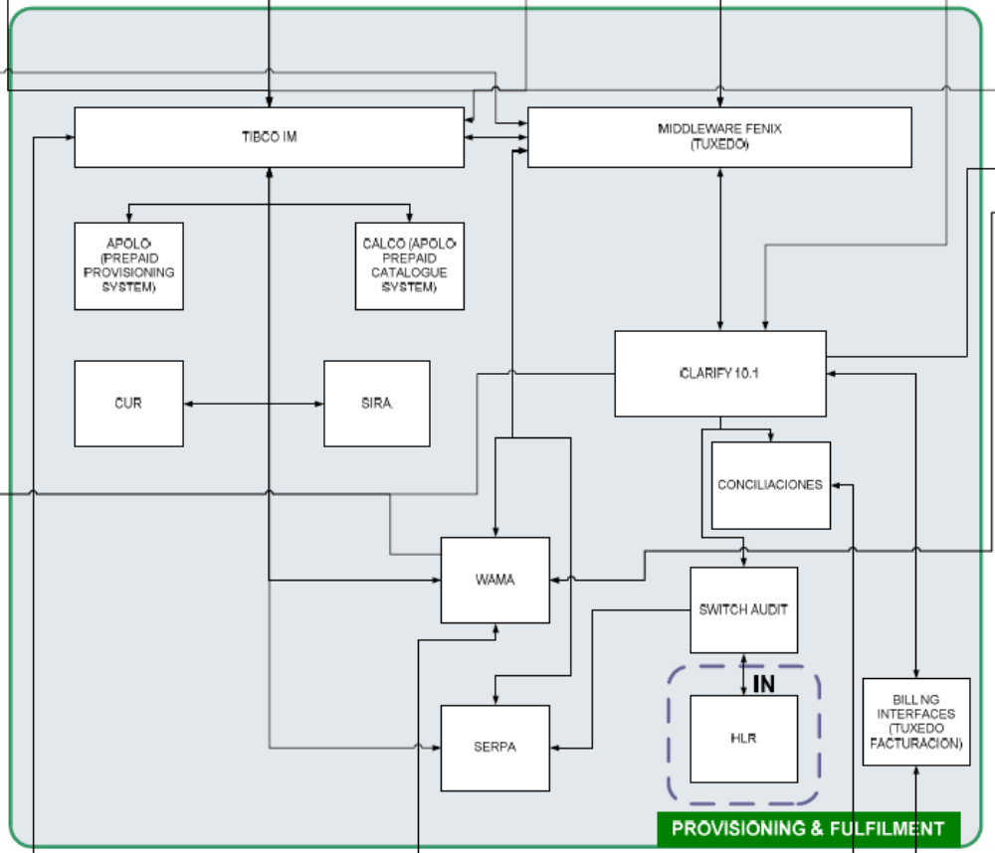
Provisioning Architecture
Customer Management
Sales and
Marketing
Enterprise
Management
Business
Intelligence
Billing

Slide 5
Platform & TIBCO Products used
Platform
  SUN Sparc (25000) Solaris 8, for mostly (IM, BW and the most of the adapters)
  HP UX 11 for Tibco Adapters for Infranet and some In house adapters
  Wintel (Windows + Intel processor) for some In house Adapters
Tibco Products used
  Tibco Integration Manager (IM) 5.0.1
  Tibco Rendezvous 7.4
  Tibco BisinessWorks 5.4.1
  Adapters:
    Tibco Adapter for ADB, LDAP, FILES, SAP R3 version 5.X
    In house adapters Tuxedo, API Middleware, FIPA, USSD, CORBA, SLS, Mapeos, Errores version 5.X (Tibco Adapter for SDK and TRA)
    Tibco Adapter for EJB, Infranet version 4.X
Main skills
  Java, TIBCO, UNIX scripting, PL/SQL

Slide 6
Provisioning Architecture-Applications
NPPI
    New promotions platform integrated
    Platform for promotions
    Stand alone applications
    This system is based on ILOG library for rules
    Oracle, Eclipse, ILOG Jrules, J2EE(Servlets, JSP, Web Logic), UNIX
    Interfaces with Application Name-Portfolio
      Clarify 10.1-Provisioning and Fulfillment
HDD (DDE(Apolo))
    History of Deactivations
    Is Information repository of inactive pre-paid services
    Oracle, Java, C, UNIX
    Interfaces with Application Name-Portfolio
      Apolo Provisioning-Provisioning and Fulfillment
      Clarify 10.1-Provisioning and Fulfillment

Slide 7
Provisioning Architecture-Applications (contd.)
  PAREX
    Is Information repository of active pre-paid services
    Oracle, Java, C, UNIX
    Interfaces with Application Name-Portfolio
      Apolo Provisioning-Provisioning and Fulfillment
  SERPA
    Provides network services provisioning application for both pre-paid and post paid customers
    Oracle, Java, C, UNIX, ASAP
    Interfaces with Application Name-Portfolio
      Apolo Provisioning-Provisioning and Fulfillment
      PRECOS-Customer Management
      NCRM (Clarify 11.5)-Customer Management
      WAMA (Post Sales Service System)-Provisioning and Fulfillment
      My Vodafone-Customer Management
      Switch Audit-Provisioning and Fulfillment

Slide 8
Provisioning Architecture-Applications (contd.)
  Switch Audit
    Compares info between systems (Clarify10.1,CUR,PAREX etc) and network systems (HLR etc) and decides the action
    For avoiding the fraud (Revenue assurance)
    ASAP, C, Java, Oracle, UNIX
    Interfaces with Application Name-Portfolio
      SERPA-Provisioning and Fulfillment
      Clarify 10.1-Provisioning and Fulfillment
  TUXEDO
    Connect systems like CRM(Clarify), SERPA(ASAP), Arbor(billing), Mediation systems, SAP, TIBCO
    C, Shell Scripting, Sybase, Java-X Windows
    Interfaces with Application Name-Portfolio
      Apolo Provisioning-Provisioning and Fulfillment
      ARBOR-Billing
      Clarify 10.1-Provisioning and Fulfillment
  Prepaid Catalog (Apolo Catalog System)
    Catalog of services to check which services can be provided
    C, XML, Oracle
    Interfaces with Application Name-Portfolio
      Apolo Provisioning-Provisioning and Fulfillment

Slide 9
Provisioning Architecture-Applications (contd.)
  Activa (Clarify 10.1)
    Handles front-end for post-paid products
    Key link for billing activation (post paid)
    Handles order fulfillment provisioning
    Used for Physical Resource Management – stock control, inventory, etc.
    Provisioning for pre-paid and post-paid
    New customers activation and customer deactivation
    Clarify, Sybase
    Interfaces with Application Name-Portfolio
      IRIS-Sales and Marketing
      Portability System-Customer Management
  TIBCO Integration Domain, Web Components TIBCO
    EAI Middleware and Prepaid Provisioning System
    Java, Perl, PL/SQL, J2EE with JSP, Servlets, Applets, Beans, EJB and Java library, Oracle
    Interfaces with Application Name-Portfolio
      NCRM (Clarify 11.5)-Customer Management
      Infranet-Billing
      Tibco Error Manager-IT Management
      Tibco Statistics Manager-IT Management

Slide 10
Provisioning Architecture-Applications (contd.)
  IRIS
    Manages automatic activations through the web
    The real activation is created by Activa which receives the IRIS requests
    Java, Weblogic, Unix
    Interfaces with Application Name-Portfolio
      Clarify 10.1-Provisioning and Fulfillment
      Activa (Clarify 10.1)-Customer Management
  Apolo Provisioning
    Transfers pre-paid order provisioning functionality out of Clarify 10.1 and into TIBCO
  WAMA
    Manages Warranty and Returns functionality
    Is the web application that supports post-sales model
    It manages handset repairing and replacement lifecycle and SIM card change

Slide 11
Team’s Responsibilities
-Shaifali Aggarwal
-Aditi Sharma
-Nupur Gupta
-Manisha Sharma
-Sandeep Beniwal
-Satish Kumar
-Dhirendra P Jaiswal
-Gaurav Saxena
-Abhinav Agarwal
-Deepaksha Chadha
-Anshu Sagar
-Gagandeep Malhotra
-Pankaj1 Kumar, Manoj Agarwal2
Review Code & Documents
Understand Application Functionality
Create AID & Other Documents
Prepare Question list
Update SPOC for progress, issues
Perform KT & On the Job Training..
Target
  50% AID complete by 10-Sep-07

Slide 12
Migratable FTEs
  NPPI and HDD will be the first 2 applications that will be migrated
  1 PM
  1 TL
  6 FA
  5 Program Analyst
  5 Programmers
  Total FTEs for NPPI : 18
  Total FTEs for HDD : 2
  Heaviest Applications- High Business Criticality, High Complexity
    TIBCO ~ 62 FTEs
    Activa (Clarify 10.1) ~ 60 FTEs

Slide 13
    Thank You !!

